Slide 1

Personal Virtual Assistant(Minor Project)
PRESENTED BY : MIRZA NAUMAAN
ENROLLMENT NUMBER :
UNIVERSITY : INSTITUTE OF ADVANCED RESEARCH

Slide 2
What is a Personal Virtual Assistant?
A personal virtual assistant is a software application that can perform various tasks and provide assistance based on user commands. Personal virtual assistants can be programmed to understand natural language and provide personalized recommendations to users.
AI-powered software that helps manage and control smart home devices, providing voice-activated commands and personalized assistance
Task Management
Personalized Insights
Organize your schedule, set reminders, and stay productive.
Get personalized recommendations based on your preferences and habits.
Voice Recognition
Instant Access to Information
Get information on any topic, from weather updates to the latest news.
Control your device in a hands-free manner.

Slide 3

Technical Aspects of Virtual Assistant: Unveiling the Inner Workings
Dive into the intricate architecture and design principles of virtual assistant. Gain insights into the cutting-edge technologies powering natural language processing, voice recognition, and smart device integration, enabling a frictionless user experience.
Embrace the possibilities that private virtual assistants bring to smart homes, enhancing convenience, efficiency, and creating an intelligent living environment.

Slide 4
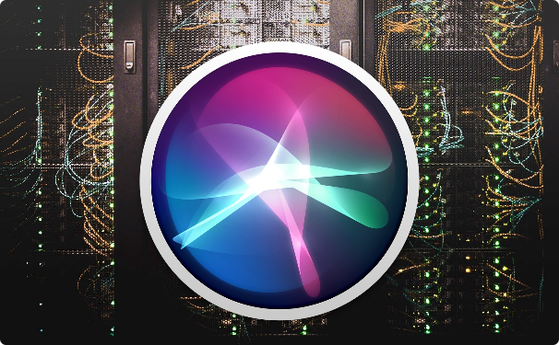
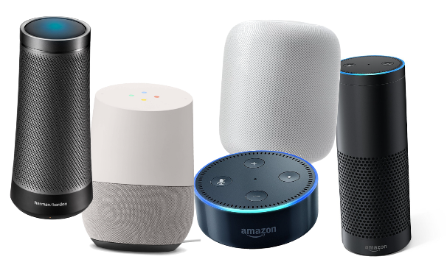
Based on Artificial Intelligence
AI has been revolutionizing the world with its advancements in machine learning, natural language processing, and computer vision. Machine learning, an integral part of AI, can be used to build personal virtual assistants that provide a personalized experience to its users.
The Rise of Virtual Assistants
Smart Speakers
Virtual assistants like Siri, Alexa, and Google Assistant have become ubiquitous in the world of AI, paving the way for personal virtual assistants.
Smart speakers with inbuilt virtual assistants have become increasingly popular in households, with more than 39 million units sold in 2020 alone.

Slide 5

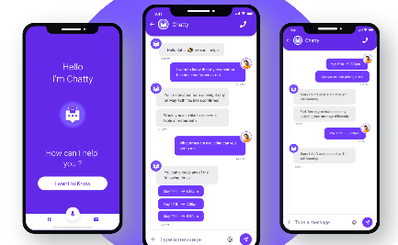

Identifying User Requirements and Expectations
Personas and User Journeys
Choosing the Right Channels
Gathering Feedback
Solicit feedback from early users to improve the assistant's performance and adaptability to different users.
Create detailed user personas and journeys to identify the user flow and requirements.
Select the channels and platforms where the virtual assistant will interact with your target audience best.

Slide 6
Selecting the Right AI Technologies
1
Speech Recognition
Select reliable speech recognition software that provides high recognition accuracy rates
Natural Language Processing
2
Opt for a natural language processing engine that can process all types of user queries sophisticatesly
3
Machine Learning
Implement machine learning techniques to personalize the user experience and recommendations offered

Slide 7

Raspberry Pi Role
Get acquainted with the Raspberry Pi, a powerful single-board computer. Learn about its features, capabilities, and set it up as the brain for your virtual assistant.
Python is a highly versatile programming language, making it an ideal choice for building personal virtual assistants. Here are some syntax examples for implementing the key features:
Personalized Reco. & Insights
Voice Recognition
Task Management & Reminders
Generating personalized recommendations: import pandas as pd import numpy as np data = pd.read_csv('user_data.csv') correlation_matrix = np.corrcoef(user_data) recommendations = correlation_matrix[-1:].flatten() recommended_items_id = [] for i in np.abs(recommendations).argsort()[::-1]: recommended_items_id.append(i)
Implementing voice recognition: import speech_recognition as sr - Initialize the recognizer r = sr.Recognizer() - Listening to the user with sr.Microphone() as source: audio = r.listen(source)
Defining and setting reminders: import datetime date = datetime.datetime.now().strftime('%Y-%m-%d %H:%M') task_input = input('What do you need to do? ') task = {task_input: date}- Get list of tasks for t in task: print(t)

Slide 8



Key Features and Functionalities
Speech Recognition and Natural Language Processing
Task Automation and Scheduling
Integration with Other Platforms
Automate and schedule tasks like setting reminders, booking appointments more efficiently.
Integrate with other apps and services for more personalised recommendations and task optimisation.
Enable voice recognition and natural language processing so that the assistant can understand and interpret user queries correctly.

Slide 9
Key Features of a Personal Virtual Assistant
To build an efficient virtual assistant, certain features must be incorporated into the software. These features should include voice recognition, task management, and personalized insights.
1
Voice Recognition and Natural Language Processing
Task Management and Reminders
2
Identify user commands and provide personalized responses
Manage user schedules and provide reminders for important tasks
3
Personalized Recommendations and Insights
Provide tailored recommendations and insights based on user data

Slide 10

Testing and Troubleshooting
Check out the performance of virtual assistants with multiple connections of different bandwidths including 2G, 3G, 4G, 5G and Wi-Fi.
Make sure the application is working smoothly while it switches from one network to another.
Make sure the messages are delivered instantly to the user.
Ensure the videos and images shared by users are loading fast with no resolution issues
Check whether the quality of video and voice calls are smooth and clear
Load test the application to identify how many concurrent customers can access the application. You can JMeter for this testing.
Find out the maximum number of users that can be active in a group chat concurrently.

Slide 11
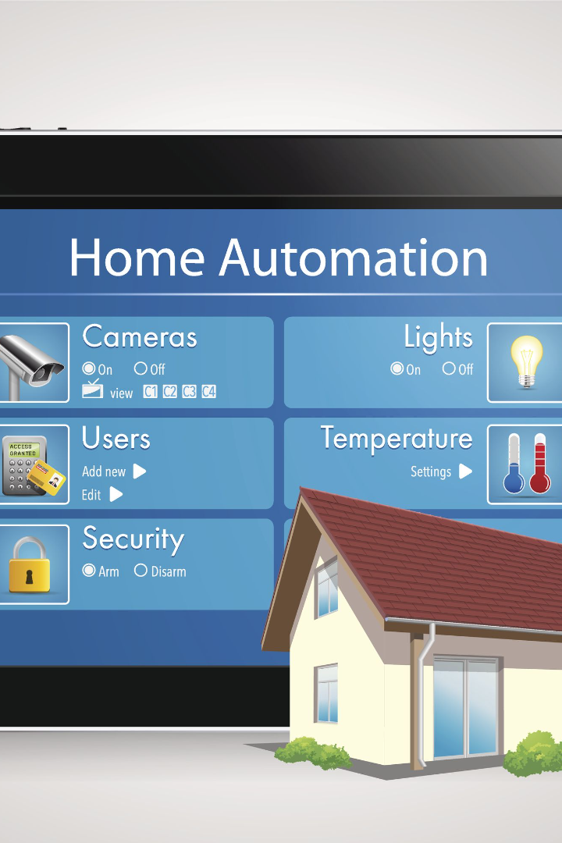
Private Virtual Assistant for Smart Home Project
Discover the future of smart homes with a private virtual assistant that seamlessly integrates with your devices, automates tasks, and provides a personalized user experience.

Slide 12
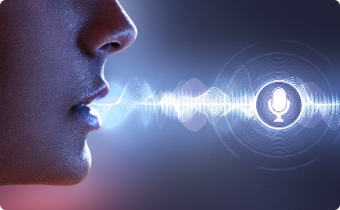
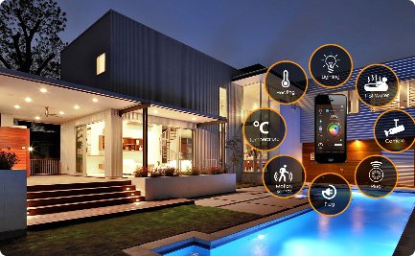

Task Performance
Voice Recognition and Natural Language Processing
Integration with Smart Home Devices
Task Automation and Scheduling
Your virtual assistant seamlessly connects with various smart home devices, enabling you to control your lights, thermostats, and more, all from one central hub.
Leverage the power of automation to simplify your daily routines. Schedule tasks like turning off lights, adjusting temperature, and even brewing coffee.
Communicate with your virtual assistant using natural language commands, allowing for a more intuitive and user-friendly experience.

Slide 13

The Heart of Your Smart Home System: Features
1
Voice Control 🗣️
2
Scheduling ⏰
Command your smart home system with your voice, eliminating the need for manual controls.
Set schedules for your fans, lights, and temperature, making your home more energy-efficient and comfortable.
3
Remote Access 📱
4
Seamless Integration 🤝
Control your home with your smartphone while you're away to ensure comfort, security, and energy savings.
Integrate your smart home system with other devices to create a truly connected and automated home.

Slide 14

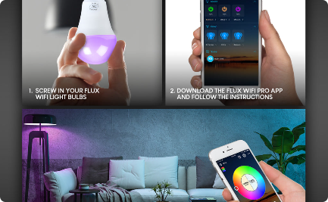
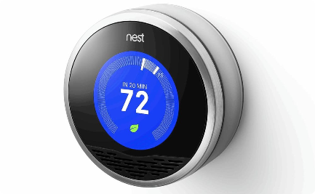
Cool Down Your Home, Just By Saying So
Controlling Fans
Light up Your Life
Temperature Regulation
Simply say the word, and your virtual assistant will control your fans, so you can focus on staying cozy.
Turn on/off and dim your lights with ease, creating the perfect ambiance for any occasion.
Control your thermostat, adjust the temperature, and optimize energy savings using only your voice.

Slide 15

Use-case Diagram

Slide 16


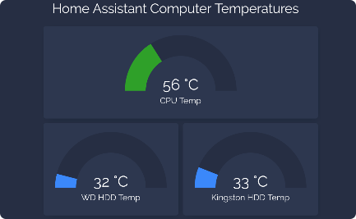
Experience the Future of Home Automation for Yourself
Great User Experience
Smart Device Integration
Easy to Install
Enjoy a user-friendly experience and discover the full potential of your smart home assistant.
With one seamless system for all your smart devices, you'll enjoy an even easier user experience.
Connect your smart home assistant to the IOT devices in your home with ease, for an effortless installation process.

Slide 17
Schedule Home Tasks Using Raspberry Pi And IOT Codes
Raspberry Pi
IOT Codes
Maximizing Efficiency
Connect your smart home system to a Raspberry Pi to enable advanced scheduling features.
Use IOT codes to automate your home's tasks and synchronize your home appliances like never before.
Optimize energy consumption and maximize efficiency by scheduling your appliances to operate at specific times of the day.

Slide 18
Design and Development Process
Integration with Other Platforms and Services
Programming and Testing
User Interface Design
Design an easy to use and intuitive user interface for the virtual assistant
Integrate the virtual assistant with other platforms or services so the assistant can perform complex tasks seamlessly.
Develop the assistant and test it extensively for usability and accuracy of responses.
Time and Effort Savings
Increased Convenience and Comfort
Improved Energy Efficiency and Cost Savings
By automating repetitive tasks, a private virtual assistant saves you time and effort, allowing you to focus on more important things in your life.
No more manually controlling each device or searching for remotes. Your virtual assistant provides a convenient & comfortable smart home experience.
Effortlessly optimize energy usage through intelligent control of devices, resulting in reduced utility bills and environmental impact.

Slide 19
Challenges and Considerations
Developing a personal virtual assistant also has its challenges. Integrating the software with third-party applications, user experience challenges, and privacy and security concerns are challenges that need to be taken into account.
1
Integration with Third-Party Applications
2
User Experience Challenges and Improvements
Integrating with third-party application APIs and ensuring compatibility.
Making sure the user experience is flawless and intuitive.
3
Privacy and Security Concerns
Ensuring user data privacy and protecting against hacking attempts and data breaches.

Slide 20


Conclusion
Building a personal virtual assistant can be challenging, but it can also be rewarding. With the advancements in AI and machine learning, the future of personal virtual assistants is exciting and holds much promise.
Personal Virtual Assistants in the Future
Q&A Session
Personal Virtual Assistants are the future of productivity and convenience. Expect incredible innovation in this field in the years to come.
We hope our presentation provided helpful insights. We now welcome any questions you may have concerning the creation and use of personal virtual assistants.

